Slide 1
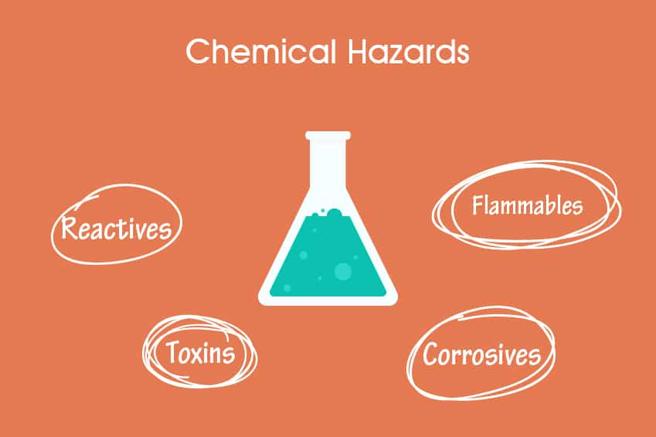
Chemical Reaction Hazards
Unit -2

Slide 2
What kind of chemical reaction in process industries?

Slide 3
What are chemical reaction hazards?
Raw materials react together during the manufacture of a chemical to give the product.
Such a chemical process often releases energy in the form of heat, and the reaction is described as ‘exothermic’.
A reaction may be exothermic even if you have to heat the reaction mass initially to get the reaction started

Slide 4
Effects
When chemical reactions are not properly managed, they can have harmful, or even catastrophic consequences, such as toxic fumes, fires, and explosions.
These reactions may result in death and injury to people, damage to physical property, and severe effects on the environment.
Process Safety Management is used to prevent and mitigate chemical reactivity hazards.

Slide 5
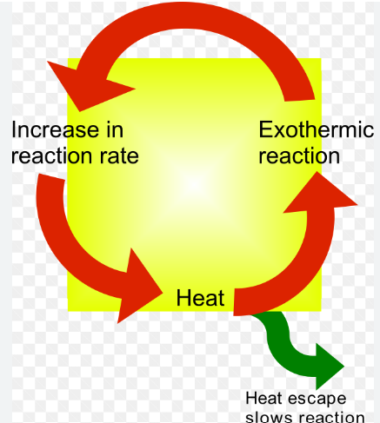
Thermal runaway
An exothermic reaction can lead to thermal runaway, which begins when the heat produced by the reaction exceeds the heat removed.
The surplus heat raises the temperature of the reaction mass, which causes the rate of reaction to increase.
This in turn accelerates the rate of heat production.
Thumb rule: suggests that reaction rate –and hence the rate of heat generation – doubles with every 10 °C rise in temperature.

Slide 6
Examples - Hazards
Hazards arise due to strong oxidizing nature of nitrating mixture
Due to high flammable character (nitro derivatives/explosive nature)
Toxicity – caused by inhalation and skin absorption
Adopted only automatic control

Slide 7

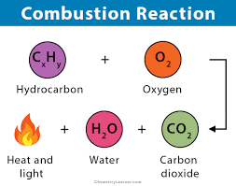
Combustion
The burning of solid, liquid, and gaseous fuels as a source of energy is very common.
Using sufficient and reliable combustion controls, this process seldom causes serious problems. However, some combustion processes are deliberately carried out with an inadequate oxygen supply in order to obtain products of incomplete combustion.
Explosive mixtures sometimes occur, and then flashback is a serious problem.

Slide 8
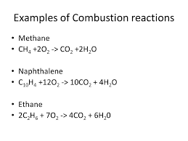

Slide 9
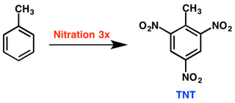
Nitration
All nitration reactions are potentially hazardous because of the explosive nature of the products and the strong oxidizing tendency, characteristic of the nitrating agent.
The nitration reaction and the oxidation side reaction are highly exothermic. Therefore, these reactions may be extremely rapid and become uncontrollable.
Close temperature control must be maintained.
Sensitivity is enhanced by the presence of impurities, and rapid autocatalytic decompositions, i.e. fume-offs, may be violent.
Eg) nitrobezene, TNT

Slide 10
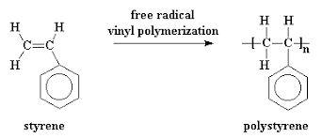
Polymerization
Polymerization is the joining together of molecules to form chains or other linkages
Chain reactions proceed quickly following slow initiation. Heat effects can be sudden, especially where catalysts are used, and may become uncontrollable, particularly as the viscosity of the reaction mixture increases.
Eg) Styrene (with heat of polymerisation of 17 kcal/mol) can vapourise air mixture with exposure limits

Slide 11
Polymerization
Sufficient surface cooling and auxiliary cooling, e.g. refluxing liquid, should be provided. An adequate, dependable supply of coolant is essential for control of exothermic reactions.
Instrumentation for control of chemical processes is extremely complex as temperature and pressure limits are approached. However, most instrument-control systems are designed to "fail safe" upon failure of the computer, electric power, or the instrument air supply.

Slide 12
Halogenation
Heats of reaction are highly exothermic for halogens, particularly fluorine, and chain reactions can result in explosions over broad concentration ranges. Halogens also present severely challenging corrosion problems.

Slide 13
Hydrogenation
Generally exothermic in vapour phase
Except for the difficulties of using hydrogen under very high pressures and at moderately high temperatures, hydrogen reactions are not particularly hazardous.
Moderately exothermic, uncontrollable conditions are rarely encountered, except where hydroxylamine intermediates can be formed.
Eg)CO methanol to parrafins

Slide 14
Oxidation
Safe reactions depend on limiting the concentration of oxidizing agents or oxidants, or on low temperature.
The following should be used with extreme caution:
salts of permanganic acid
hypochlorous acid and salts
sodium chlorite and chlorine dioxide
all chlorates; all peroxides, particularly organic peroxides
nitric acid
nitrogen tetroxide
ozone

Slide 15
What do you need to do?
To deal with chemical reaction hazards you first need to identify them.
Then you need to decide how likely they are to occur and how serious the consequences would be. This is known as risk assessment.
You are required by law to assess the risks that the process presents and, if you have five or more employees, to record the significant findings.

Slide 16
Safety measures
Once you know what the risks are, you can select the measures to ensure safe operation.
You can ensure safe operation in a number of ways, by using: inherently safer methods, which eliminate or reduce the hazard;
process control, which prevents a runaway reaction occurring; and
protective measures, which limit the consequences of a runaway

Slide 17
Inherent safety
Where possible, you should first eliminate or reduce hazards by inherently safer design.
For example: replace hazardous materials with safer ones
Have less unreacted material in the reactor, eg using a continuous process instead of a batch reactor;
Use a semi-batch method (in which one of the raw materials is added over time) instead of a batch process; and/or ■■ use a heating medium which has a maximum temperature that is too low for the reaction mixture to decompose

Slide 18
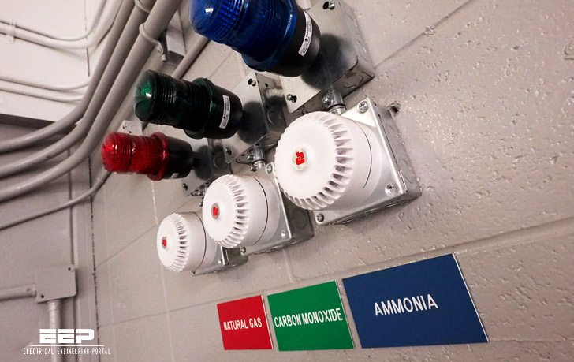
Process control
Process control includes the use of sensors, alarms, trips and other control systems that either take automatic action or allow for manual intervention to prevent the conditions for uncontrolled reaction occurring.
Specifying such measures requires a thorough understanding of the chemical process involved, especially the limits of safe operation.
Alarm in industry

